Slide 1
Forces in Earth

Slide 2
History of plate tectonics
Plate tectonic theory had its beginnings in 1915 when Alfred Wegener proposed his theory of "continental drift."
Paleontologists had also found that there were fossils of similar species found on continents that are now separated by great geographic distance.
These observations seemed to indicate that the Earth's lithosphere had been moving over geologic time.
Paleomagnetic studies, which examine the Earth's past magnetic field, showed that the magnetic north pole seemingly wandered all over the globe. This meant that either the plates were moving, or else the north pole was.
The Earth has undegone several magnetic reversals in the past, in which the north and south poles are reversed for a period of time. When geologists and geophysicists discovered that the crust in the ocean recorded these reversals, it was even more positive proof that the lithosphere had to be in motion

Slide 3
Earthquake and it’s detection
Movements within the Earth’s crust cause stress to build up at points of weakness and rocks to deform.
When the stress finally exceeds the strength of the rock, the rock fractures along a fault, often at a zone of existing weakness within the rock. The stored energy that is suddenly released as an earthquake!
Intense vibrations, or seismic waves, spread out from the initial point of rupture, the focus, like ripples on a pond. These waves are what makes the ground shake and can travel large distances in all directions.

Slide 4
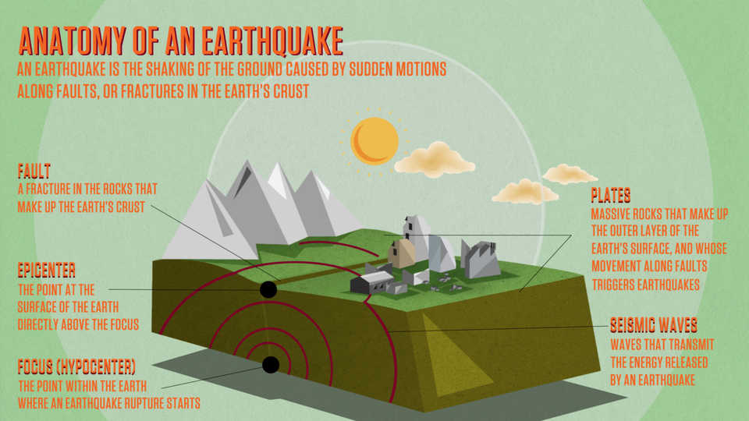

Slide 5
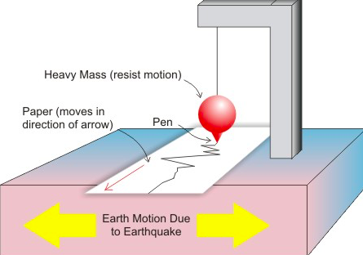
Seismometer

